Slide 1
Heaps
CS221N, Data Structures

Slide 2
Heaps: Motivation
Recall priority queues. What were they?
  An ordered queue
  Offered us O(1) removal, searching of:
    The largest element if ordered from highest to lowest
    The smallest element if ordered from lowest to highest
  Insertion still takes O(n) time
Heaps attempt to accomplish the same thing with a tree where a node is always larger than its children
  Enforce balancing
  O(log n) insertion, O(log n) deletion
  O(1) searching of maximum element (max-heap)
    You could trivially accomplish O(1) for the minimum as well

Slide 3
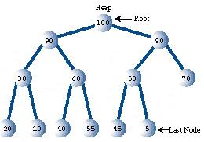
Heap: Binary tree
Note: A heap is NOT a binary search tree.
  Each node has two children
  Instead of the left child being smaller and the right child larger, both children are smaller (heap condition)

Slide 4
Complete
A heap is a complete binary tree
  In that, each row is completely filled in reading from left to right
  The last row need not be

Slide 5
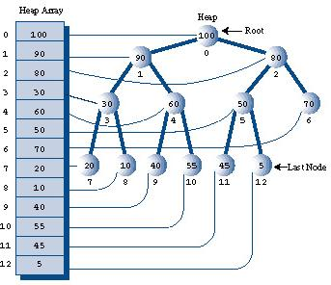
Array Implementation
Heaps are usually implemented with arrays
  It will become clear why

Slide 6
Traversal
Note: An inorder traversal of the heap is very difficult!
  Because the elements are weakly ordered
  The heap condition is not as strong as the organizing principle in the binary search tree
  Thus this operation is not supported by heaps

Slide 7
Arbitrary search and deletion
Searching and deleting any element other than the maximum is also not supported
  For the same reasons, they are difficult and expensive
There are actually only two operations that a heap supports….

Slide 8
Supported Operations
A heap only supports two operations:
  Deletion of the maximum element
  Insertion of a new element
These are actually the two required operations for a priority queue!

Slide 9
Operation 1: Removing the max
We already know that the maximum element is:
  At the root of the heap
  At position 0 of the heap array
Generally, follow these steps:
  Remove the root
  Move the last node into the root
  Trickle the last node down until it’s below a larger node and above a smaller one

Slide 10
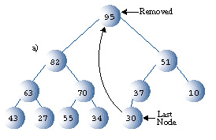
Example
Delete node 95 (the max) from the following heap:

Slide 11
Step 1
Remove the root and replace it by the last node

Slide 12
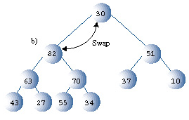
Step 2
Trickle the node down the tree, swap until it lies between larger and smaller nodes

Slide 13
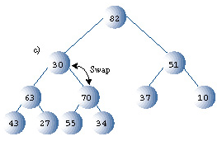
Step 2
Trickle the node down the tree, swap until it lies between larger and smaller nodes

Slide 14
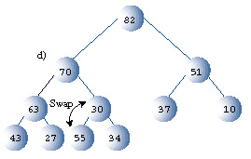
Step 2
Trickle the node down the tree, swap until it lies between larger and smaller nodes

Slide 15
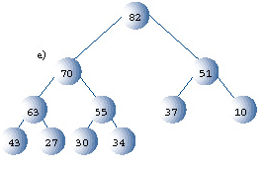
Step 2
Trickle the node down the tree, swap until it lies between larger and smaller nodes

Slide 16
Implementation
Assuming we know the current size of the array (call it n), removing the root and replacing it with the last node is easy
  Just set heapArray[0] equal to heapArray[n-1]
  And decrement n

Slide 17
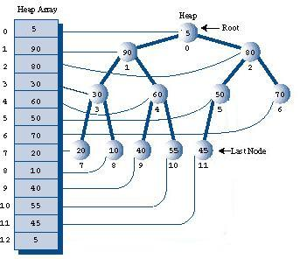
Trickling Down
Once we’ve moved the last element to the root, if either or both children are larger:
  Find the bigger child and swap

Slide 18
Trickling Down
Note, given a node at index x:
  Its parent is at (x-1)/2
  Its children are at 2x+1 and 2x+2

Slide 19
Trickling Down
So generally, for trickling down:
  Start x at 0
  while (heapArray[x] < heapArray[2x+1] or
  heapArray[x] < heapArray[2x+2])
  largerChild = max(heapArray[2x+1], heapArray[2x+2])
  swap(heapArray[x], largerChild)
  if (largerChild was left child)
  x = 2x+1
  else
  x = 2x+2
  Of course, we need checks if we are at the bottom…

Slide 20
Java Implementation, page 592
We’ll avoid the extra Node class and just use integers
Let’s construct
  A constructor, which takes a maximum heap size
  A function to check if the heap is empty
  A function to accept an index and perform a trickle down
  A function to perform the deletion of the maximum element

Slide 21
Operation 2: Insertion
Generally, follow the following steps:
  Insert the new node at the next available spot in the bottom row
  If it violates the heap condition (translation: it’s bigger than its parent)
    Trickle the node upwards, until it’s smaller than the parent

Slide 22
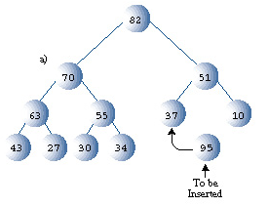
Example
Add node 95 to the following tree:

Slide 23
Step 1
Put the new node in the next empty spot

Slide 24
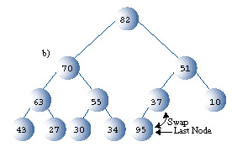
Step 2
If the node is larger than the parent, swap it

Slide 25
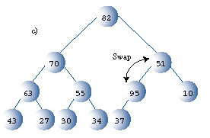
Step 2
If the node is larger than the parent, swap it

Slide 26
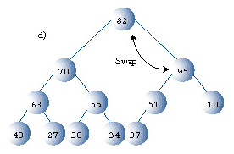
Step 2
If the node is larger than the parent, swap it

Slide 27
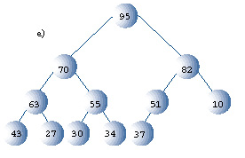
Step 2
We’re done! We actually added a new maximum.

Slide 28
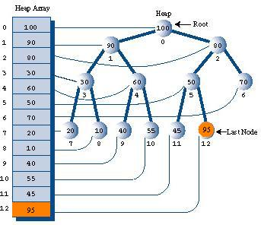
Implementation
Once again, step 1 is easy
  If the current size of the heap is n
  Set heapArray[n] to the new key
  Increment n

Slide 29
Trickling Up
Again, given a node at index x:
  Its parent is at (x-1)/2
  Its children are at 2x+1 and 2x+2

Slide 30
Trickling Up
General approach will be:
  while (heapArray[(x-1)/2] < heapArray[x] and we’re not at the root)
  swap(heapArray[x], heapArray[(x-1)/2]
  x = (x-1)/2
Let’s look at the implementation..

Slide 31
Java Implementation, page 592
Again, we’re avoiding the Node class and just using integers
Let’s implement
  Constructor
  Function to check if the heap is empty
  A function which takes an index and trickles that node up
  A function which performs the insertion

Slide 32
Let’s do our own example…
Begin with an initially empty heap, with a maximum size of 10. Perform the following operations, showing both the array contents and the corresponding heap:
    Insert 64
    Insert 91
    Insert 80
    Insert 21
    Insert 45
    Remove the max
    Insert 110
    Insert 35
    Remove the max
    Remove the max
    Insert 204

Slide 33
Efficiency
Swapping just takes O(1) time
Trickle up and trickle down each take O(log n) time
  They each iteratively examine parent nodes
  A heap is necessarily balanced because of its completeness
Resizing the array is not overly difficult, although is not a desirable operation and should be done minimally
  O(n) copies!

Slide 34
Why use arrays?
Actually you can use trees if you want to
  This is called a tree heap
  Let’s construct the Node class… will look similar to the binary search tree (but remember the properties are different!)
Difficult to implement however
  If you know how many elements are in the tree, you can find the last element by converting the size to binary
  For example, if there are 29 nodes:
    29 = 11101 in binary. Remove the first digit, get 1101
    Go right (1), right (1), left (0) and right(1) to get to the 29th node
    Once you find the last node, our operations become relatively easy
    But you’re adding an O(log n) operation just to find the last element. ☹

Slide 35
Heapsort
If I had a collection of n integers that I wanted to sort:
  Insert all n into the heap
  Remove the maximum element n times
  Really? That easy?
Yes!

Slide 36
Heapsort Efficiency
Let’s look at each operation:
  Insert all n into the heap
  Remove the maximum element n times
  Really? That easy?
So we perform n insertions and each are O(log n) -> O(n log n)
And we perform n removals of the max, each are O(log n) -> O(n log n)
So our heapsort is O(n log n) and ties quicksort?!?

Slide 37
Actually, not quite…
But it is pretty good!
It is not quite as fast as quicksort, because…
  In the inner loop of trickling down, there are more operations than in the inner loop of quicksort
  Many assignments and comparisons
  To see this, just look at the implementation on page 594
We can make heapsort more efficient, however!

Slide 38
New Insertion Process
The one we learned:
  For each new node we insert:
    Place it in the last available position O(1)
    Trickle up O(log n)
    Overall, O(n log n)
The new one
  Insert all elements randomly
  Apply trickle down to any non-leaf nodes
    This saves an O(log n) process for n/2 of the nodes
Let’s see how this saves us

Slide 39
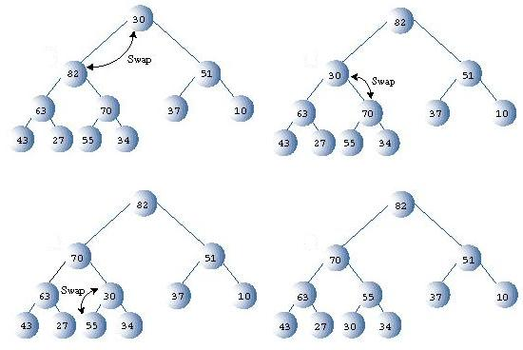
Revisiting Trickle Down…
To the right, you can see the trickling down of the root node 30:
Continue to swap positions until 30 is between a smaller and larger node

Slide 40
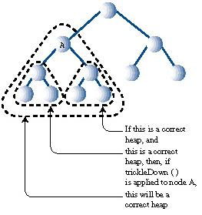
What we can note…
Trickling down requires correct subheaps

Slide 41
What we can note…
However, the leaf nodes in the bottom row, already must be correct heaps
So we don’t have to apply trickle down to them
These comprise roughly half the nodes in the tree

Slide 42
So, summary with insertion
So with insertion, we actually can save operations
  Instead of n operations of trickle up, we have n/2 operations of trickle down
Overall
  Randomly insert n elements -> n*O(1) = O(n)
  Trickle down n/2 elements -> (n/2)*O(log n) = O(n log n)
So it’s still O(n log n), but you’re doing half as many trickles
  Not a huge savings, but well worth it!

Slide 43
One way: Iteratively
Note that, the bottom row of nodes begins at index n/2
So, apply trickle down to nodes (n/2)-1 to 0 (the root)
  Note we have to go in reverse, because trickle down works properly only if subtrees are correct heaps

Slide 44
Second Way: Recursion
Called ‘heapify’, and pass a node index
Envision as:
  If the index is larger than (n/2)-1, do nothing
  Otherwise:
    Heapify the left subtree
    Heapify the right subtree
    Trickle down this node
Java implementation, page 603

Slide 45
Memory
Heapsort, as it is currently designed, requires two arrays
  One to hold the current heap
  One for temporary data that is removed
However, this does not have to be the case!
Let’s recall the operations for insertion
  Insert n elements in random order
  Apply trickle down (n/2) times
  Remove the maximum element n times

Slide 46
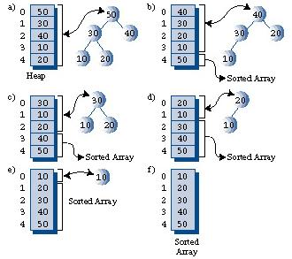
Sharing Space
Note: We don’t necessarily need two arrays for heapsort!
  n/2 trickle down operations can be easily done on the same array, it’s just swapping contents of cells

Slide 47
Sharing Space
When we remove the maximum element, one slot becomes open at the end of the subarray we are sorting
  We can just insert the maximum element there!
  The result will be a sorted array

Slide 48
(Time Pending)
Java Implementation, page 605
Summary:
  Get the array size from the user -> 1
  Fill with random data -> n
  Turn array into a heap with n/2 applications of trickle down -> (n/2)*(log n)
  Remove items from the heap -> n log n
  Write back to the end of the array -> n
Total: (3n/2)*(log n) + 2n + 1 -> O(n log n)

